Slide 1
SC1015
Mini Project
Identifying Hypertension
Lab Group FCS7 Team 9
Stephanie Heather Zaw (U2321860B)
Lee Jia Rong (U2322725D)
Yeo Jie Sheng (U2320438L)

Slide 2

Dataset Used
2021 Behavioural Risk Factor Surveillance System Survey Data and Documentation conducted be the US Centers for Disease Control and Prevention(CDC)

Slide 3
Our Motivation
Hypertension is the number one risk factor for death globally, affecting more than 1 billion people.
37.0% of Singaporeans have hypertension in 2022

Slide 4
Problem Statement
What are the variables correlated with the hypertension, and how can we identify undiagnosed individuals suffering hypertension?

Slide 5
Data Extraction and Renaming
Variable | Factors Name
_RFHYPE6 | Hypertension
_INCOMG1 | Income
_RACEPRV | Gender
_SEX | Race
_RFHLTH | Overall Health
_PHYS14D | Physical Health
_MENT14D | Mental Health
_TOTINDA | Exercise
_BMI5/_BMI5CAT | BMI
Variable | Factors Name
_MICHD | Coronary heart Disease (CHD) or Myocardial Infarction (MI)
_RFHYPE6 | Hypertension
CVDINFR4 | Heart Attack
_RFCHOL3 | High cholesterol
_LTASTH1 | Asthma
DIABETE4 | Diabetes
_DRNKWK1 | Alcoholic Consumption
_FRUTSU1 | Fruit Consumption
_VEGESU1 | Vegetable Consumption
_SMOKER3 | Smokers
_CURECI1 | e-cigarette users

Slide 6
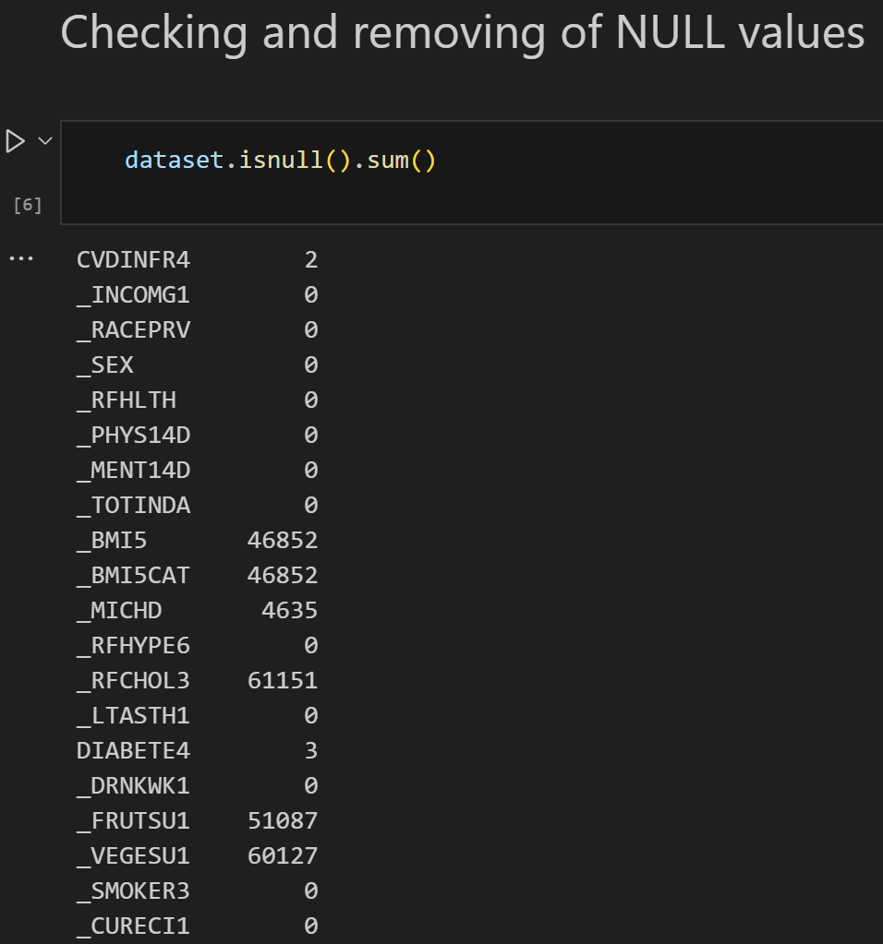
Data Cleaning
Checking and Removal of NULL values

Slide 7
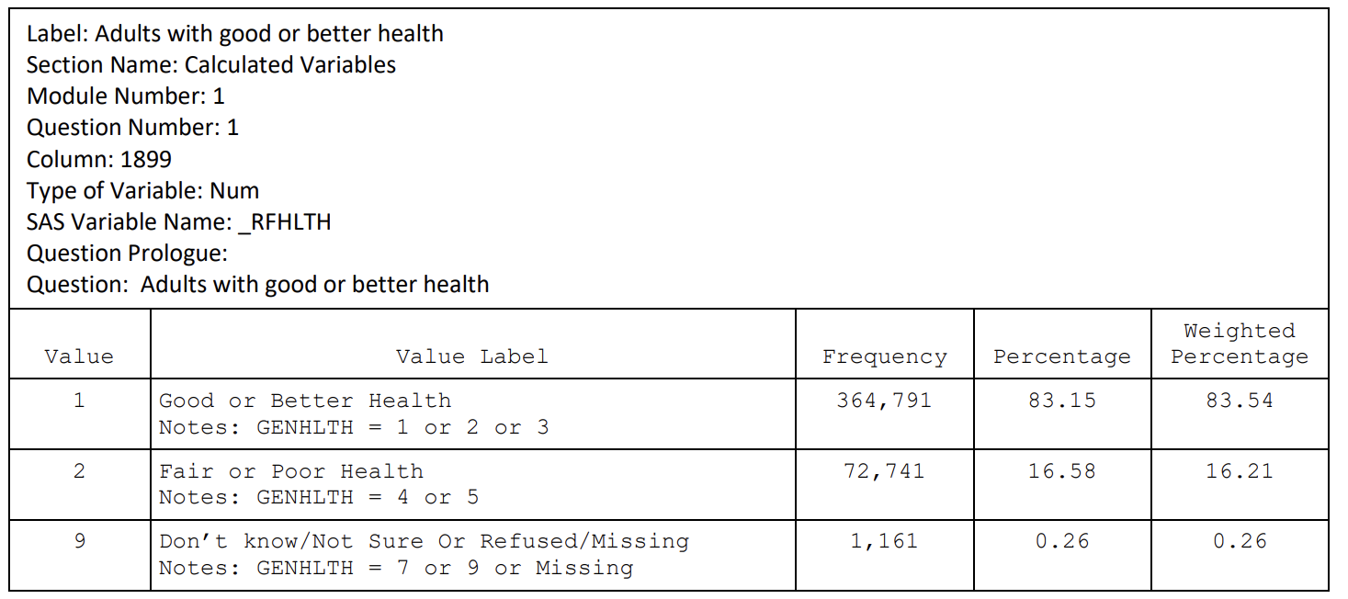
Data Cleaning
Tackling Irrelevant Data Entries

Slide 8
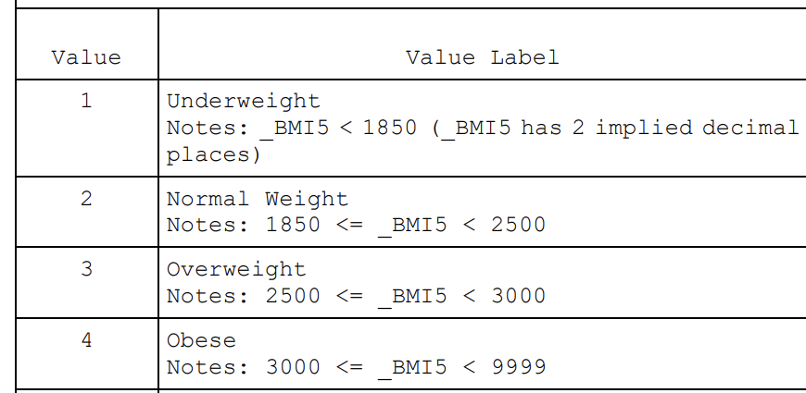
Data Cleaning
Decode the categorical variable

Slide 9
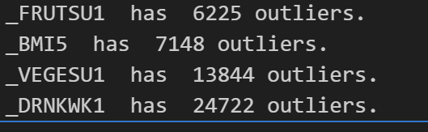
Data Cleaning
Identify and Remove Outliers

Slide 10
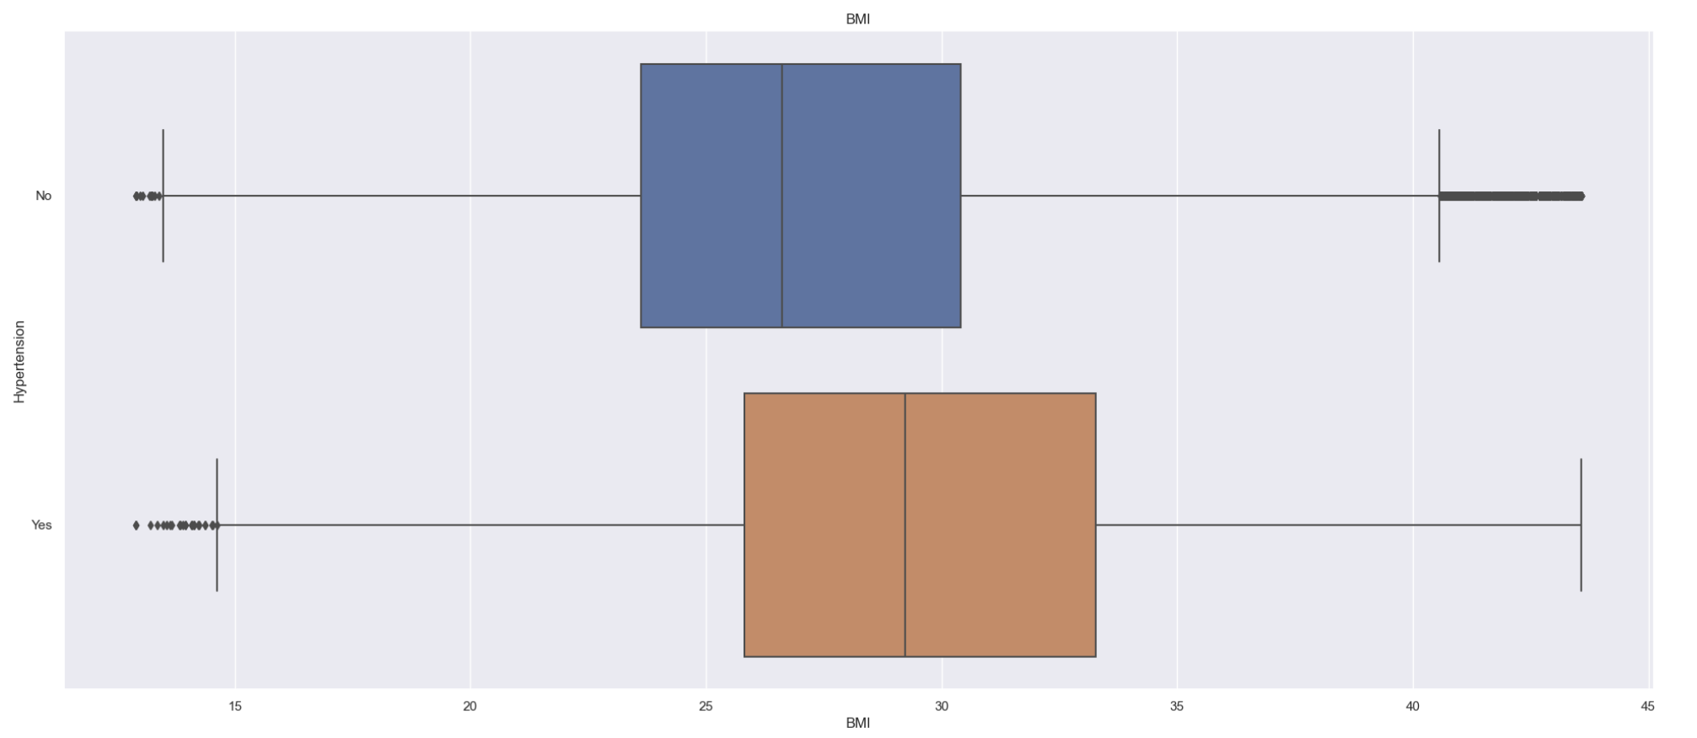
Exploratory Data Analysis
BMI

Slide 11
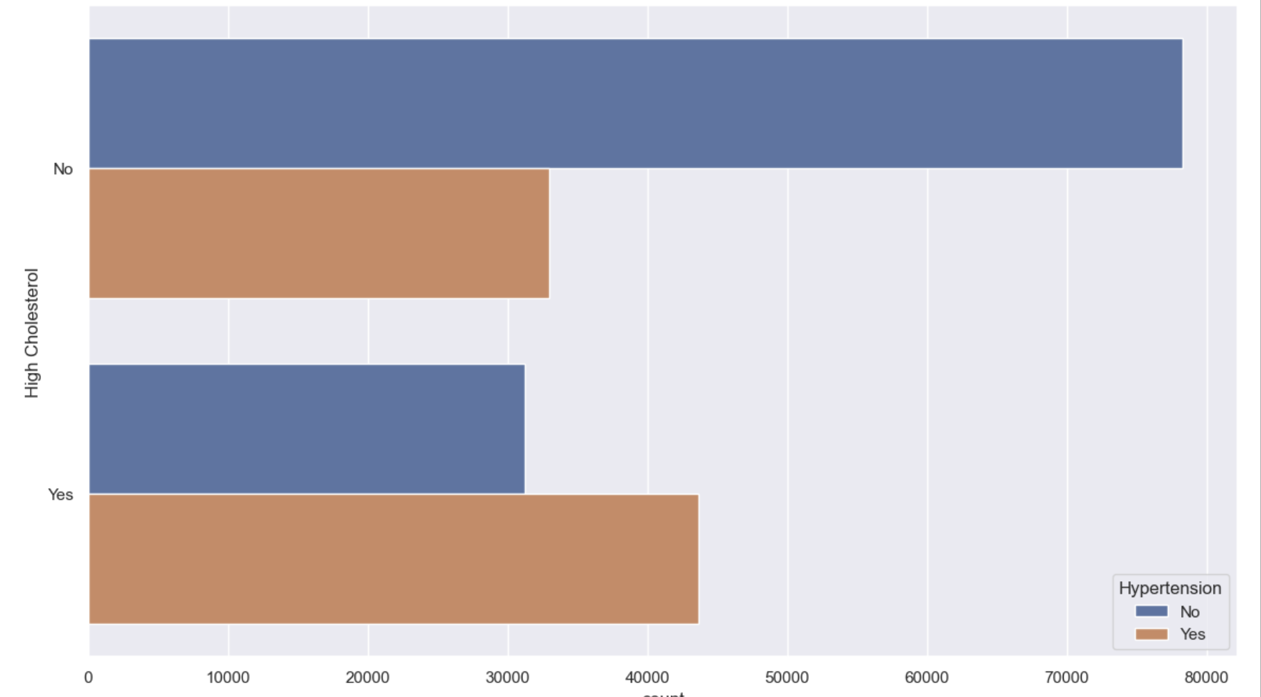
Exploratory Data Analysis
High Cholesterol

Slide 12
Exploratory Data Analysis
Important Factor
Diabetes
Overall Health
BMI
Have CHD/MI
High Cholesterol
Income
Heart Attack
Physical Health
Exercise
Final Important Factors
Diabetes
Overall Health
BMI
Have CHD/MI
High Cholesterol
Income
Main Variable
Hypertension

Slide 13
Classification Algorithms

Slide 14



Algorithms used
Decision Tree
Logical Regression
Random Forest

Slide 15
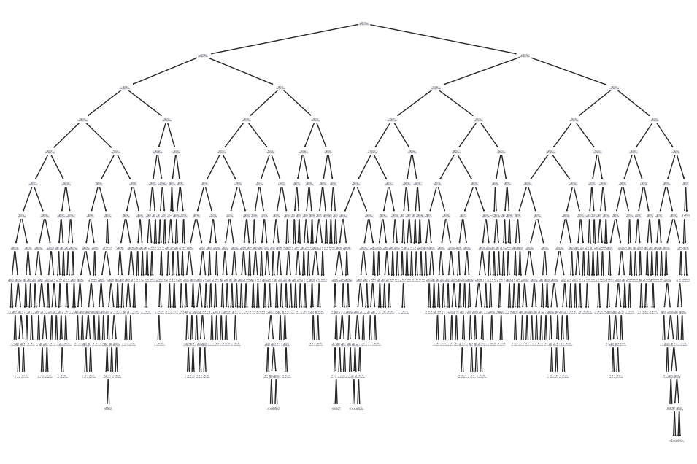
Model 1: Decision Tree
Initial Decision Tree
Decision Tree constructs a model based off decisions and their possible consequences
The tree can accurately predict the class or value of new, unseen instance
Is particularly adapt with categorical variables.
Depth of 12

Slide 16
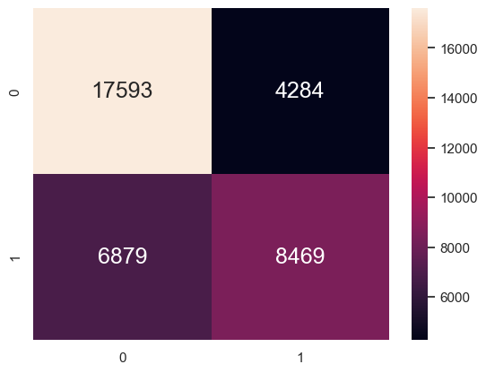
Model 1: Decision Tree
Matrix of Initial Model
Accuracy | 0.7001
True Positive Rate | 0.5517
False Positive Rate | 0.1958

Slide 17
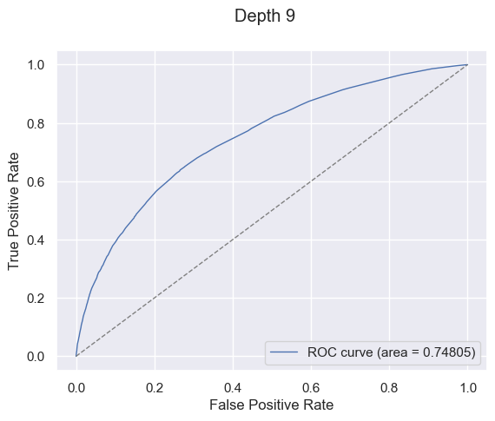
Model 1: Decision Tree
Optimisation
Depth | AUC
1 | 0.64391
2 | 0.68701
3 | 0.71296
4 | 0.72800
5 | 0.7369
6 | 0.74354
7 | 0.74636
Depth | AUC
8 | 0.74797
9 | 0.74805
10 | 0.74803
11 | 0.74803
12 | 0.74805

Slide 18

Model 1: Decision Tree
Matrix of Initial Model
Matrix of Optimized Model
 |  | Improvement
Accuracy | 0.7004 | (+0.00032236)
True Positive Rate | 0.5520 | (+0.00026062)
False Positive Rate | 0.1954 | (+0.00036568)

Slide 19
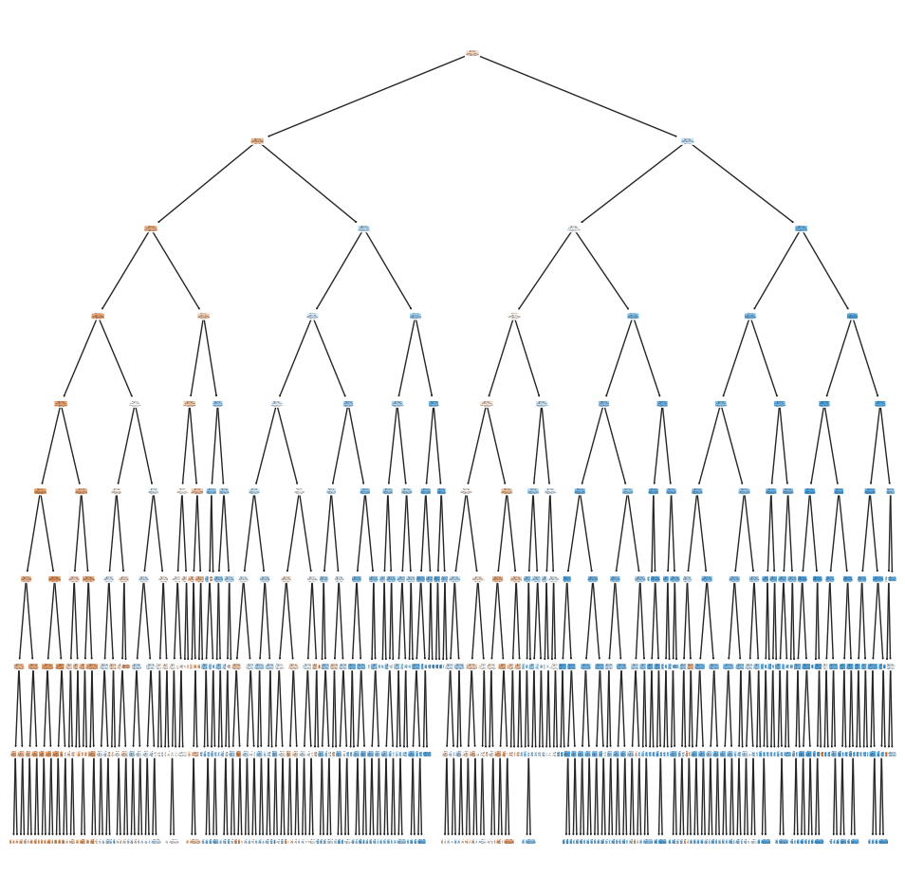
Model 1: Decision Tree
Optimised Decision Tree
Depth 9

Slide 20
Model 2: Logical Regression
Logistic Regression predicts the output of a categorical variable based on one or more independent variables
It reveals the interrelationships between variables and their impact on the outcomes
This helps us make accurate predictions

Slide 21
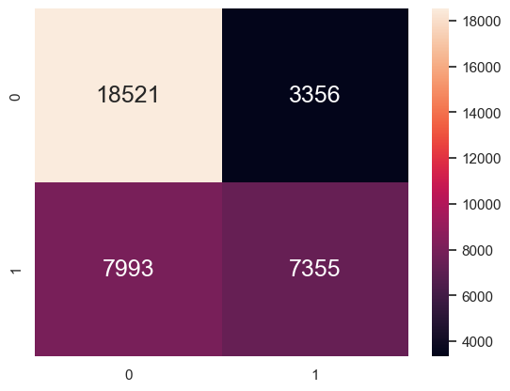
Model 2: Logical Regression
Accuracy | 0.6951
True Positive Rate | 0.4792
False Positive Rate | 0.1534

Slide 22

Model 2: Logical Regression
Optimisation
Tried to use GridSearch to optimise by finding best Hyperparameters
Imposing penalty on input variables with large coefficients]
Ensuring no overfitting
Ensure compatible solvers are used

Slide 23


Model 2: Logical Regression
Results
Accuracy | 0.6951
True Positive Rate | 0.4792
False Positive Rate | 0.1534
Initial:
Optimised:

Slide 24
Model 3: Random Forest
Random Forest combines the output of multiple decision trees to reach a single result
Suitable for large datasets with many instances and dimensions
Very easy to analyse the importance of each feature on the prediction (hypertension
We use Random Forest Classifier instead of Random Forest Regressor as our variables are categorical with discrete categories which is a classification problem.

Slide 25
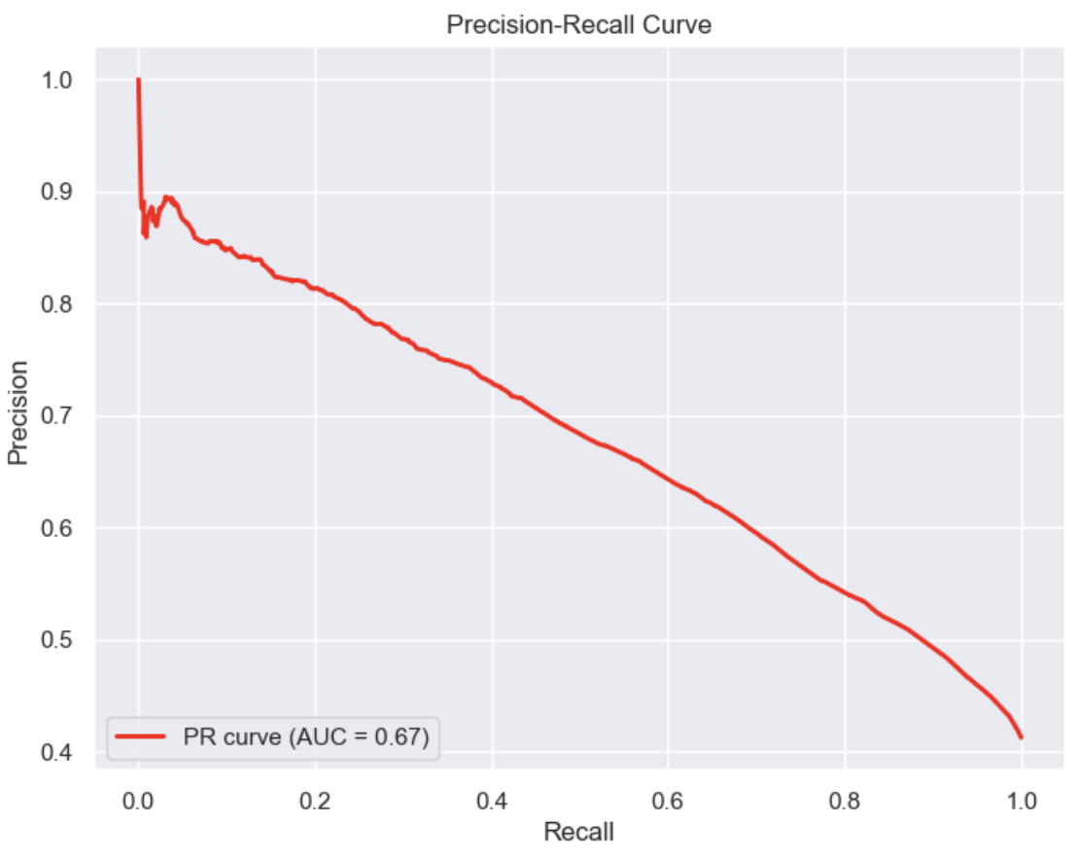
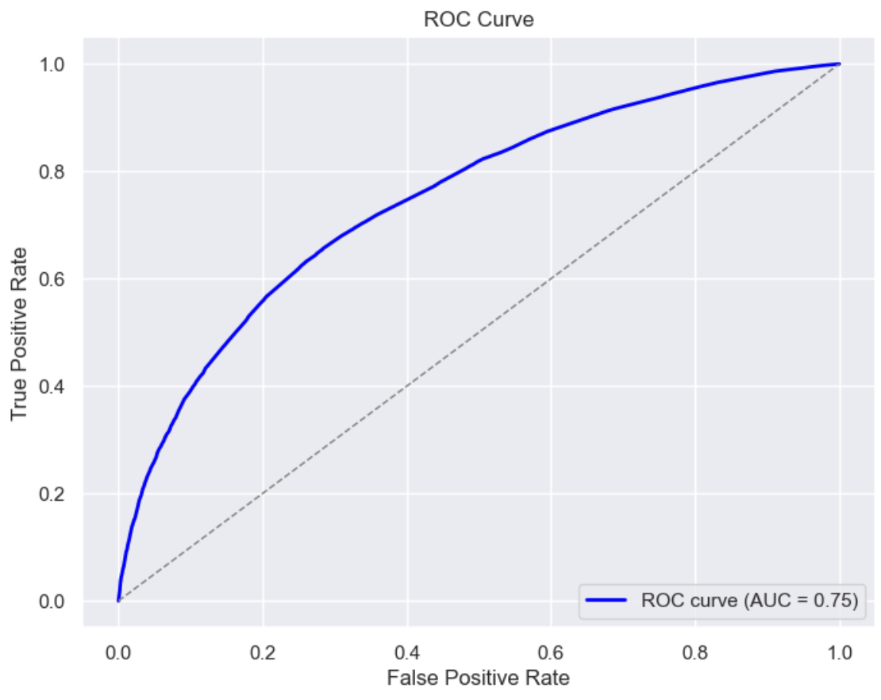
Model 3: Random Forest
ROC Curve and AUC-ROC
Notes:
The ROC curve illustrates the performance of a performance of our random forest classification model
The AUC quantifies the overall performance of the classifier

Slide 26
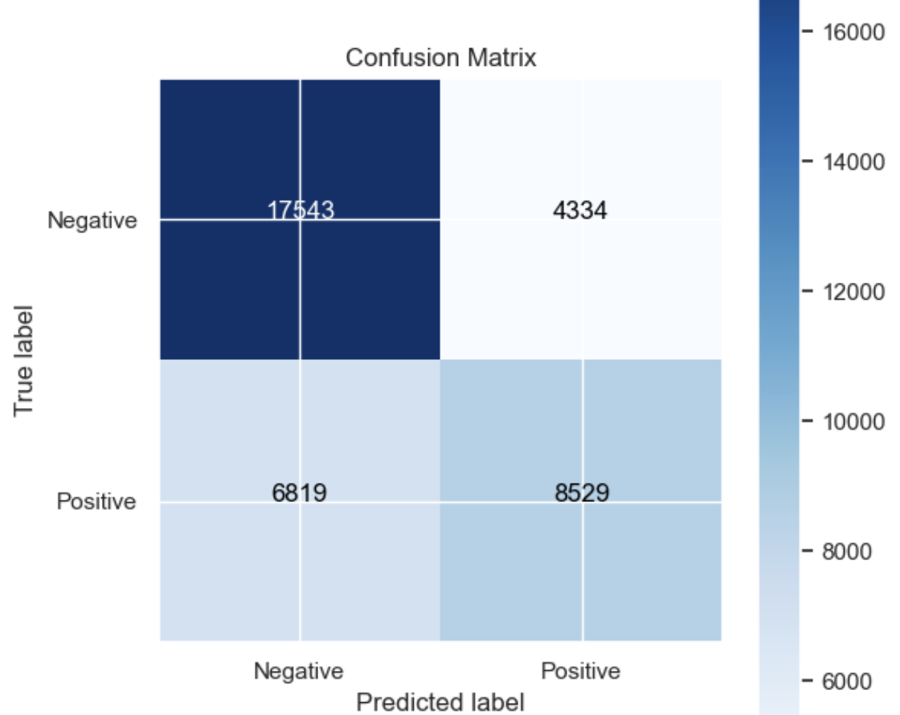
Model 3: Random Forest
Confusion Matrix
Accuracy | 0.7004
True Positive Rate | 0.5557
False Positive Rate | 0.1981
Notes:
A confusion matrix summarises the performance of a classification model on a set of test data for which the true labels are known.

Slide 27
Summary
Logical Regression
Decision Tree
Random Forest
Accuracy
TPR
FPR
0.6951 | 0.7004 | 0.7004
0.4792 | 0.5520 | 0.5557
0.1534 | 0.1954 | 0.1981
Notes:
A confusion matrix summarises the performance of a classification model on a set of test data for which the true labels are known.

Slide 28
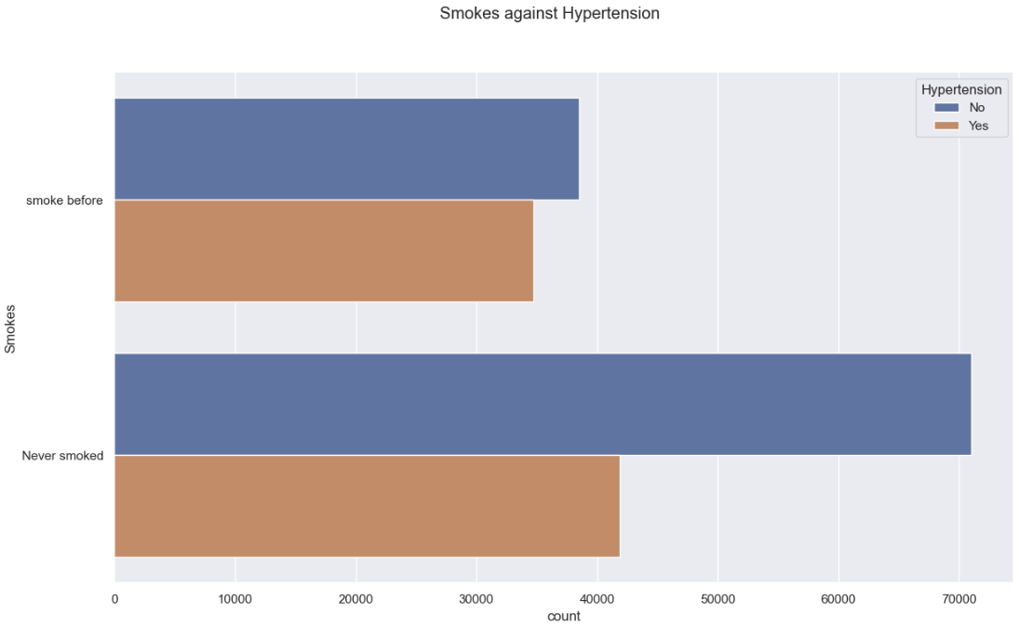
Data-Driven Insights & Findings
Smoking does not significantly contribute to hypertension

Slide 29
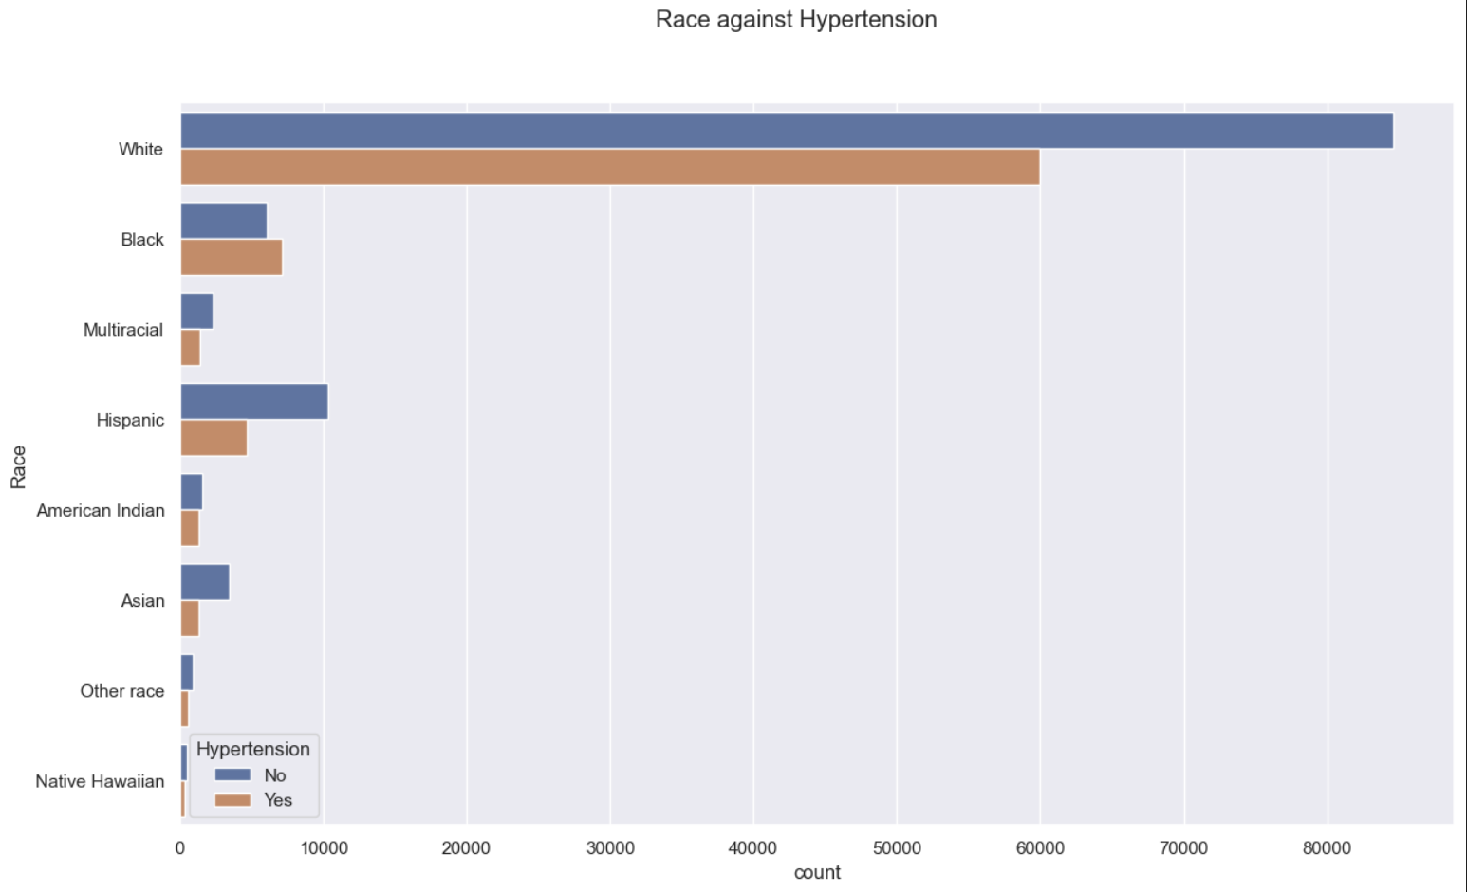
Data-Driven Insights & Findings
There is a higher proportion of hypertension among Black people compared to other races

Slide 30
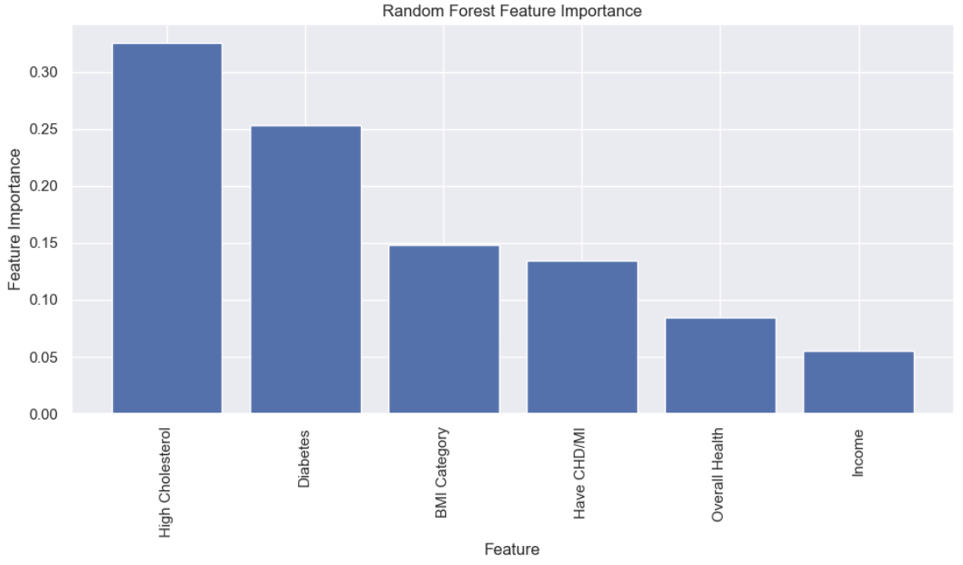
Data-Driven Insights & Findings
In predicting hypertension using random forest classifier, the 3 most influential features are:
High Cholesterol
Diabetes
BMI Category

Slide 31
Future Recommendations
High Cholesterol: Adopt a diet rich in soluble fiber & limit saturated and trans fat
Diabetes: Monitor blood sugar levels regularly
BMI: Follow a balanced diet & exercise regularly

Slide 32
Future Recommendations
Regular screening for high cholesterol, diabetes & BMI should be emphasized
More public health initiatives aimed at raising awareness about the factors of hypertension

Slide 33
Limitations & Recommendations
Data is from the US
Lifestyle factors and demographics in Singapore may be different
Genetic factors
A comprehensive survey can be conducted to investigate the underlying factors contributing to hypertension in Singapore

Slide 34
Thanks!

